Slide 1

CIT-2180 Data and Database Management Chapter 11

Slide 2

Oracle 12C: SQL
Chapter 11
Group Functions

Slide 3
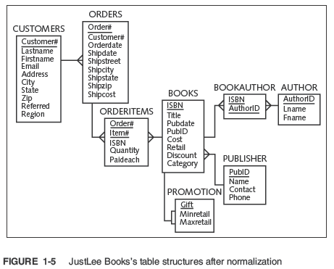

Slide 4
Group Functions
Return one result per group of rows processed
Are also called multiple-row and aggregate functions
All group functions ignore NULL values except COUNT(*)
Use DISTINCT to suppress duplicate values

Slide 5
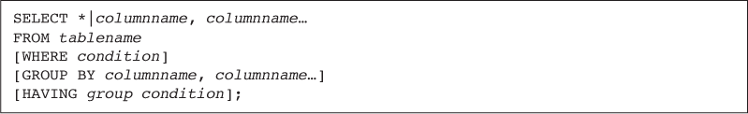
Added Clauses

Slide 6
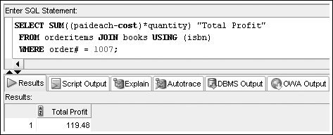
SUM Function
SUM (n) – sum for a group of rows
n – the column containing numeric data
Calculate the total profit from books sold in order number 1007

Slide 7
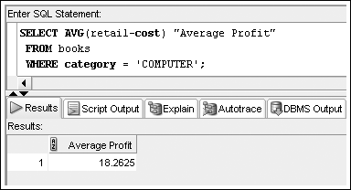
AVG Function
AVG (n) – average for a group of rows
n – the column containing numeric data
Calculate the average profit generated by all COMPUTER books

Slide 8
COUNT Function
COUNT (n) – count number of non-NULL records
n – the field to be counted (numeric, date, or character)
Two purposes
Count non-NULL values
Count total records, including those with NULL values

Slide 9
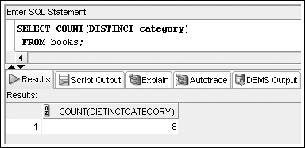
COUNT Function – Non-NULL Values
Include column name in argument to count number of Non-NULL occurrences

Slide 10
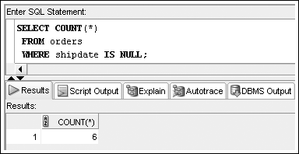
COUNT Function – NULL Values
Include asterisk in argument to count number of rows, including NULL values

Slide 11
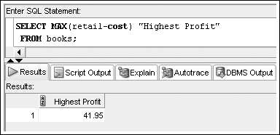
MAX Function
MAX (n)
n – the column containing numeric, date, or character data

Slide 12
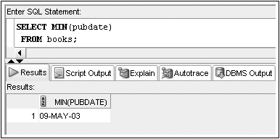
MIN Function
MIN (n)
n – the column containing numeric, date, or character data

Slide 13
Grouping Data
GROUP BY clause
Used to group data
Must be used for any individual column in the SELECT clause with a group function
Cannot reference column aliases

Slide 14
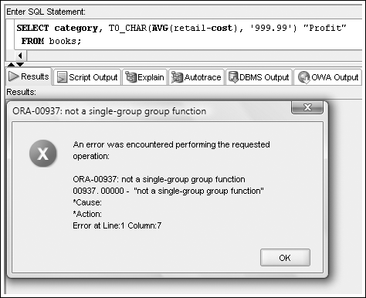
Common Error
A common error is missing a GROUP BY clause for nonaggregated columns in the SELECT clause

Slide 15
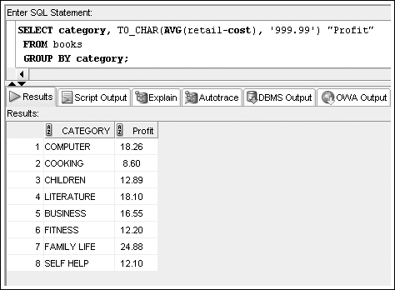
GROUP BY Example

Slide 16
GROUP BY Example

Slide 17
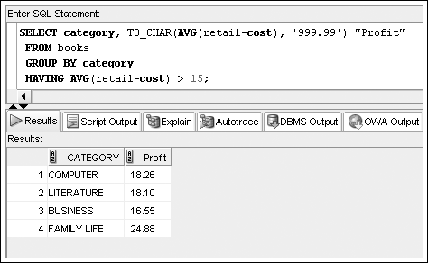
Restricting Aggregated Output
HAVING clause serves as the WHERE clause for grouped data

Slide 18
Restricting Aggregated Output (continued)
When included in the same SELECT statement, the clauses are evaluated in the order of:
WHERE
GROUP BY
HAVING

Slide 19
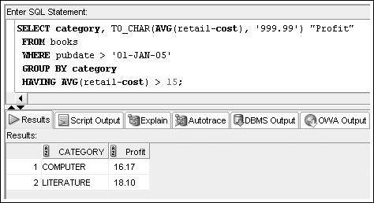
Restricting Aggregated Output (continued)

Slide 20
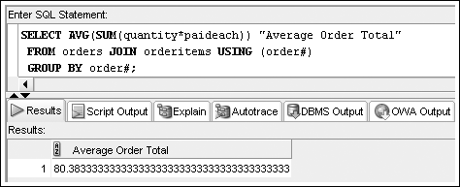
Nesting Functions
Inner function is resolved first
Maximum nesting depth of group functions: 2

Slide 21
Statistical Group Functions
Based on normal distribution
Includes:
STDDEV
VARIANCE

Slide 22
Topics not Discussed
We will not cover pages 424 – 438
ENHANCED AGGREGATION FOR REPORTING

Slide 23
Oracle 12C: SQL
END OF Chapter 11
Group Functions

